Slide 1

CREATING CONTENT FOR SOCIAL NETWORKS WITH THE INTEGRATION OF MODERN GENERATIVE ARTIFICIAL INTELLIGENCE MODELS
Performed by:
student of the group PZIP-12
Artem Verenko
Supervisor:
Ph.D., Assoc. Prof. of Software Eng. Dept.
Tetyana Marusenkova

Slide 2
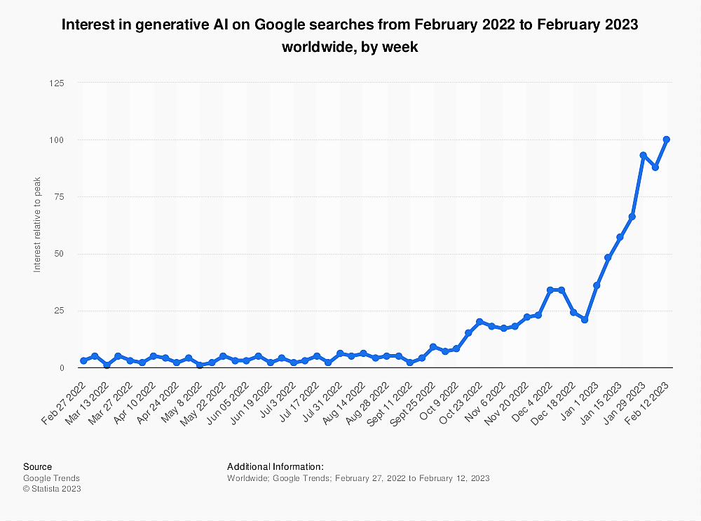
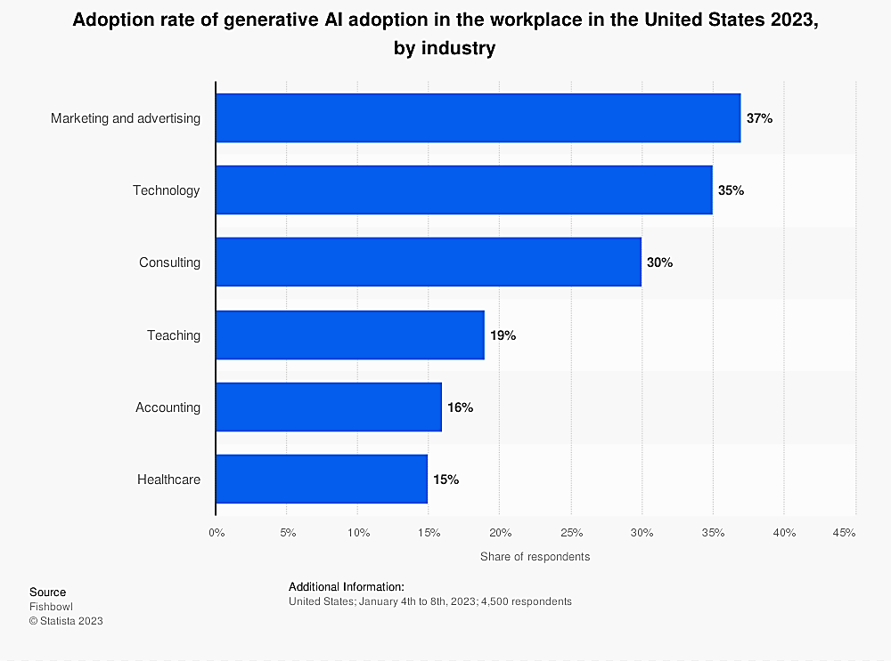
TOPICALITY

Slide 3
Research Object and Subject
The research object is the process of integrating modern generative artificial intelligence models.
The research subject is the method and technology for integrating modern generative artificial intelligence models with the original content creation system for social networks.

Slide 4
Objective and Tasks
The objective of this work is to develop an original content creation system for social networks with the integration of modern generative artificial intelligence models
Study of trends in the field of generative artificial intelligence models and their application in social networks
Development of a conceptual method for the content creation system that integrates generative models
Selection of specific artificial intelligence models for implementation
Development of functionality for generation, optimization, and sharing content
Testing and evaluating the effectiveness of the developed system

Slide 5
Expected Results
Conducted a review of modern trends in AI generative models and their application in social networks;
Identified suitable generative models for implementation in the system;
Developed a conceptual model of a content management system that integrates AI generative models;
Developed a system with the capability of interacting with users, generating, optimizing, and distributing content, which includes AI generative models;
Conducted system testing and obtained evidence of its effectiveness.

Slide 6
Providers of generative AI
API | Usage | Price | Capabilities
OpenAI | Text generation, image generation, code programming | Paid, based on used resources, named test credits | Enables the quick creation of models that can perform tasks requiring generation of content.
Amazon Generative AI API | Text, images, audio, code programming | Free usage up to 10000 requests per month; paid plans available for more extensive use | Easily integrated with other Amazon services such as AWS Lambda and Amazon S3
Google Generative AI API | Text, images, code programming | Free usage up to 100000 requests per month; paid plans available for more extensive use | Easily integrated with other Google projects for up to 3 years with services like Google Cloud Platform and Google Workspace
Meta Generative AI API | Text, images | Free usage up to 1000 requests per month; paid plans available for more extensive use | Can be integrated with other Meta projects, but not as well integrated with other Meta services
IBM Watson Assistant | Text, images | Corporate plan for its own product or free plan with more limited functionality | With the option for text recognition, the system starts with a massive dataset that allows generating text, which is simultaneously true and factual.

Slide 7
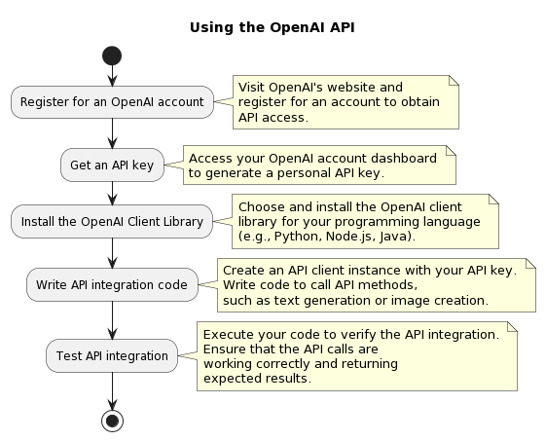

Slide 8






OBJECTS
Generative AI
Social media
USER
CMS
BD
ADAPTER

Slide 9
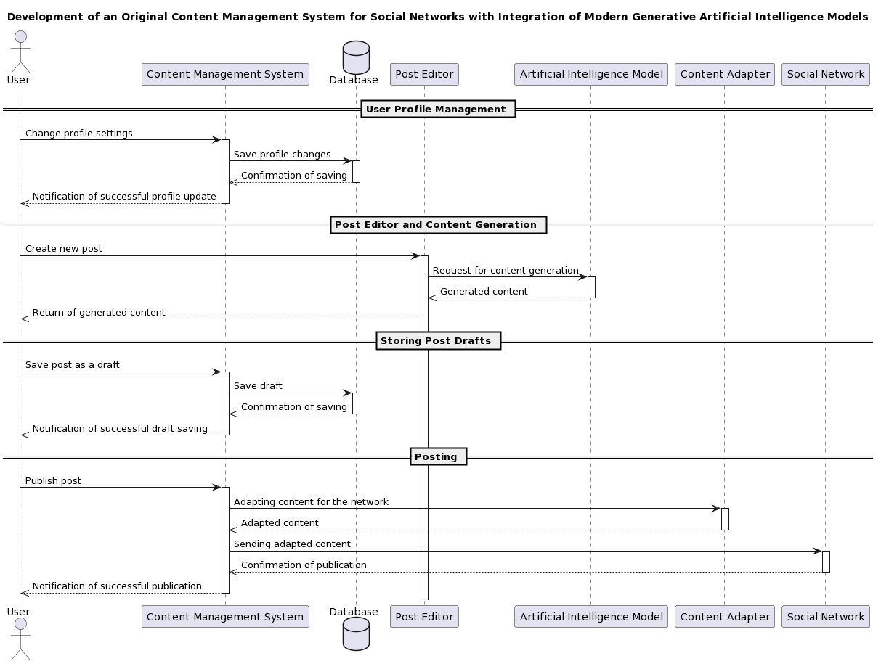
scientific novelty
Scientific
novelty

Slide 10
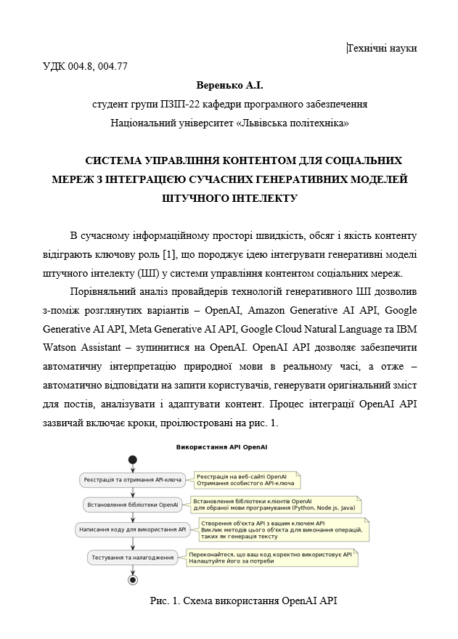


Slide 11
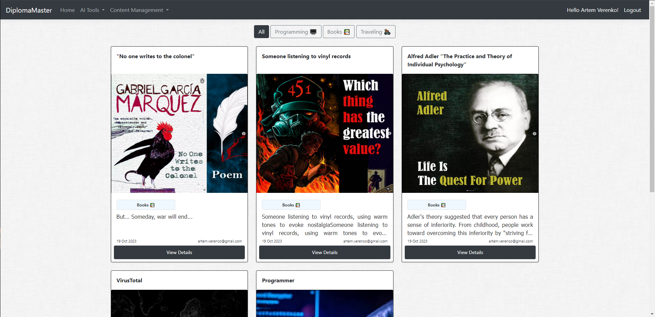

Slide 12
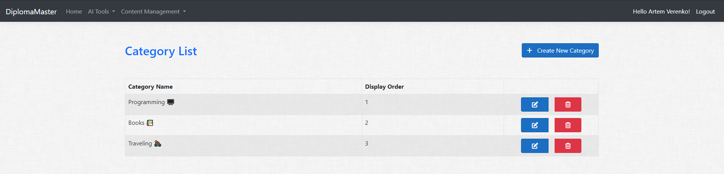
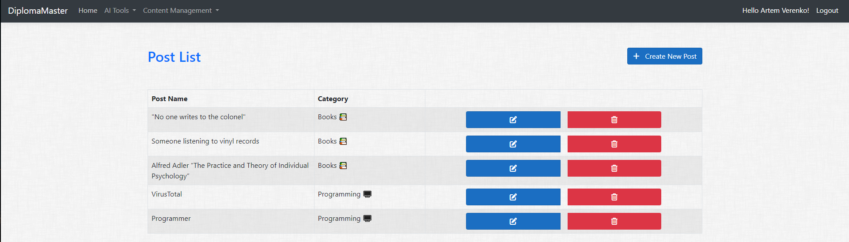

Slide 13
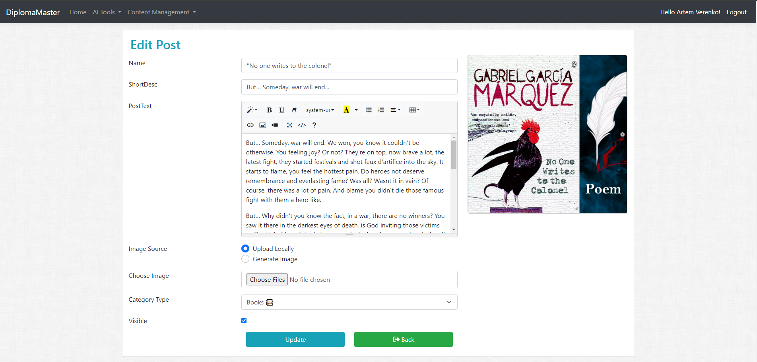

Slide 14
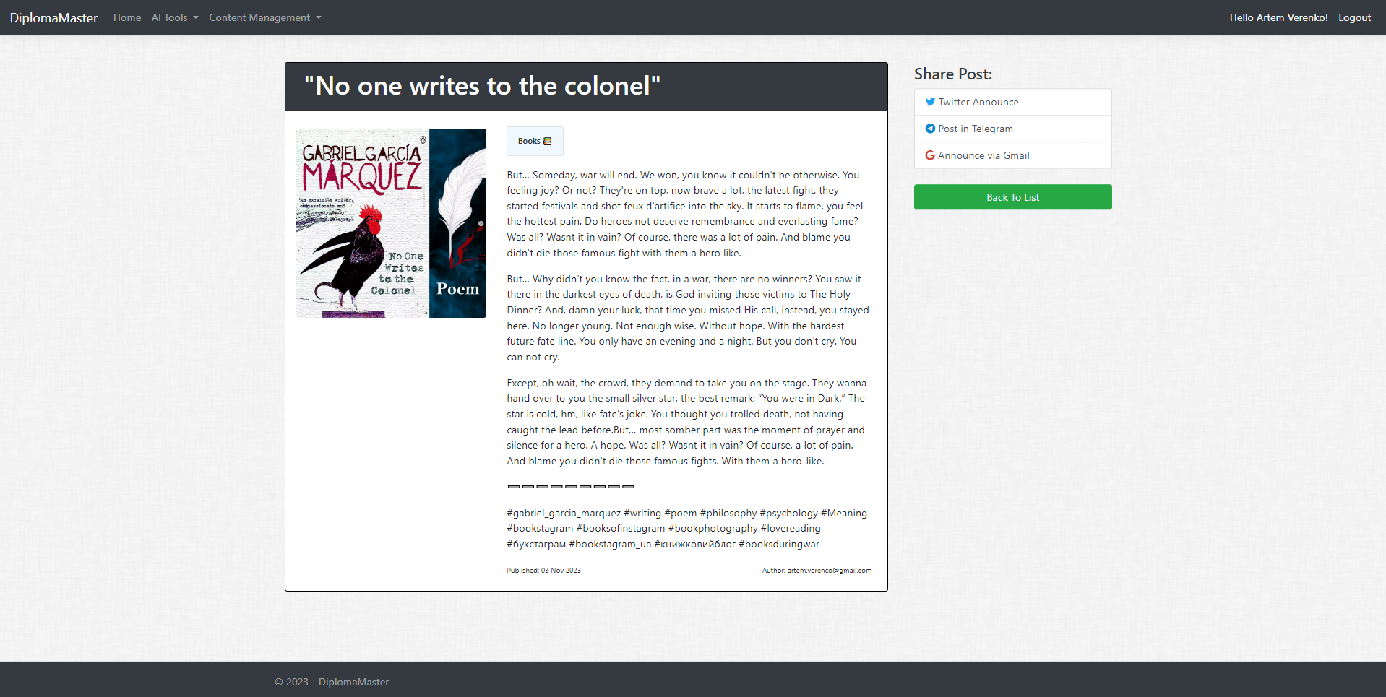

Slide 15
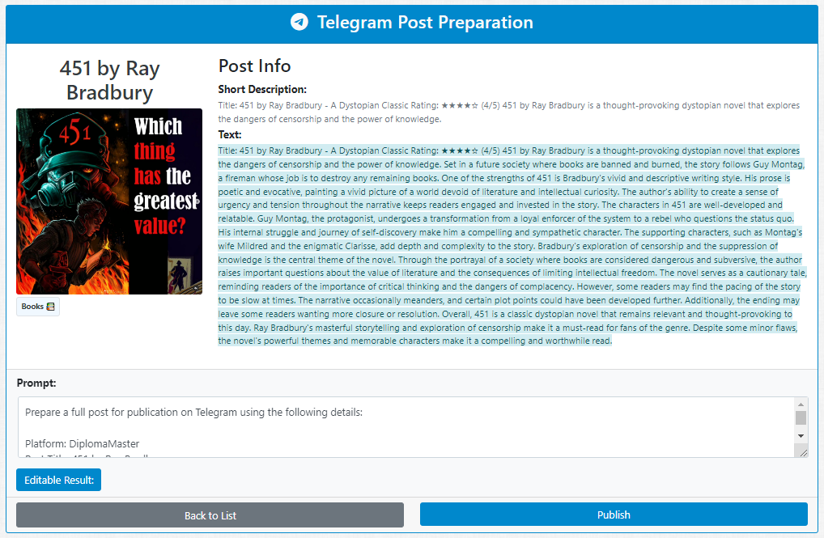
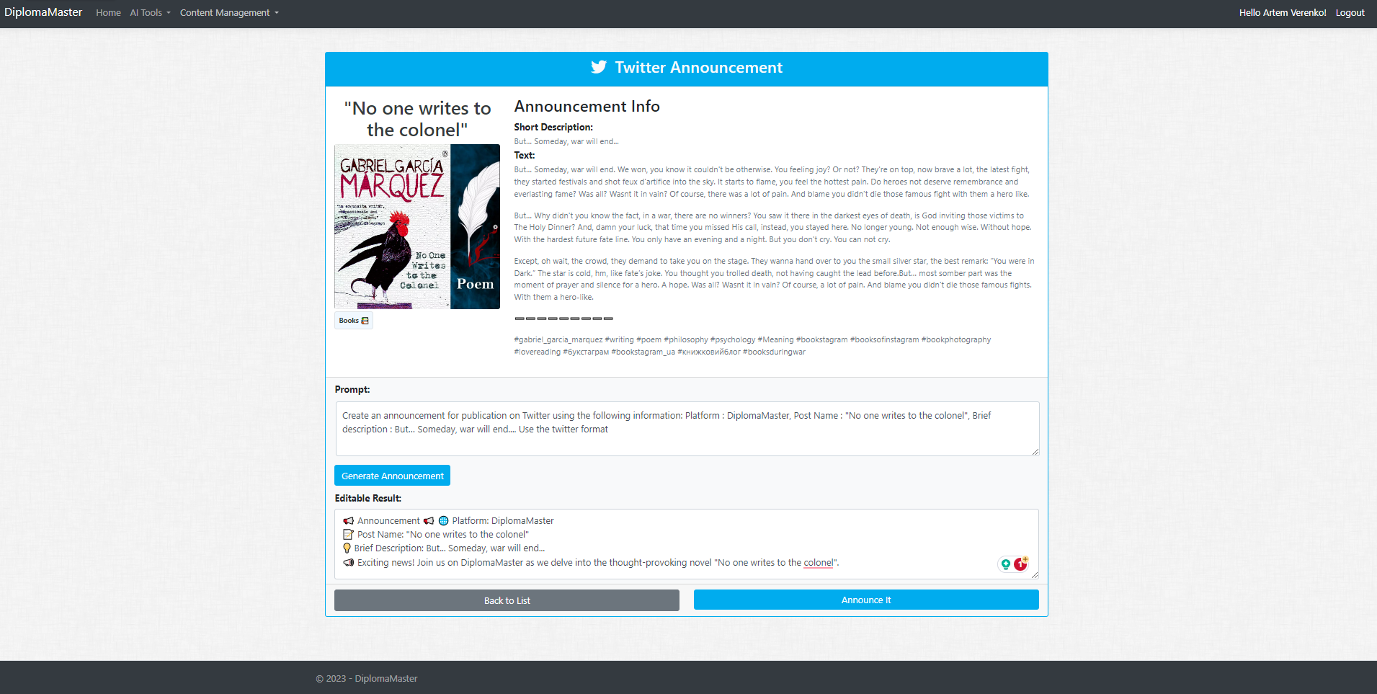
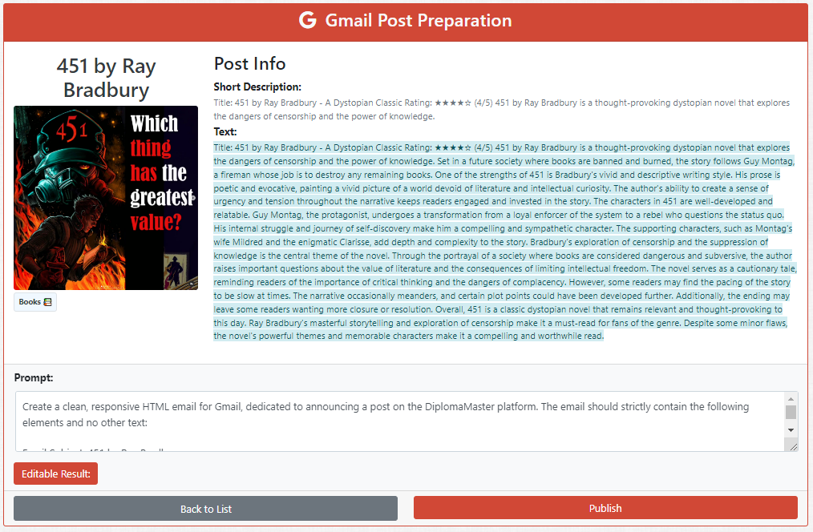

Slide 16
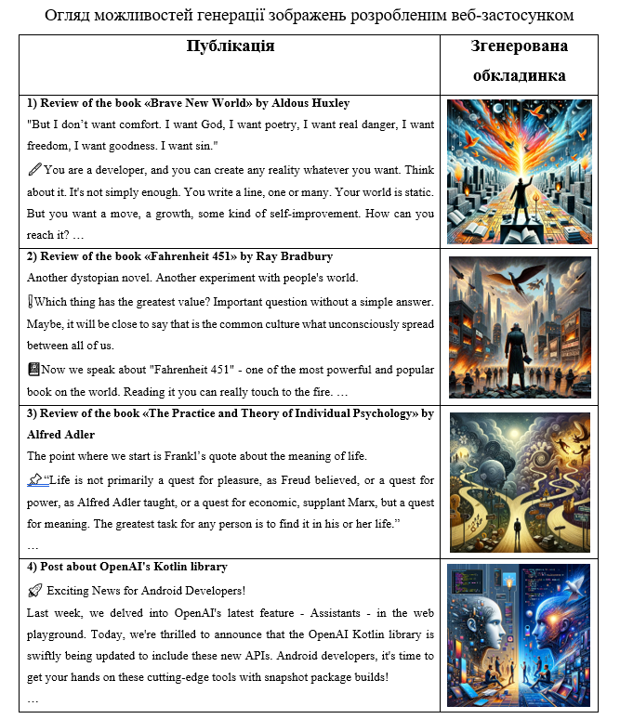
PUBLICATION
Generated cover

Slide 17
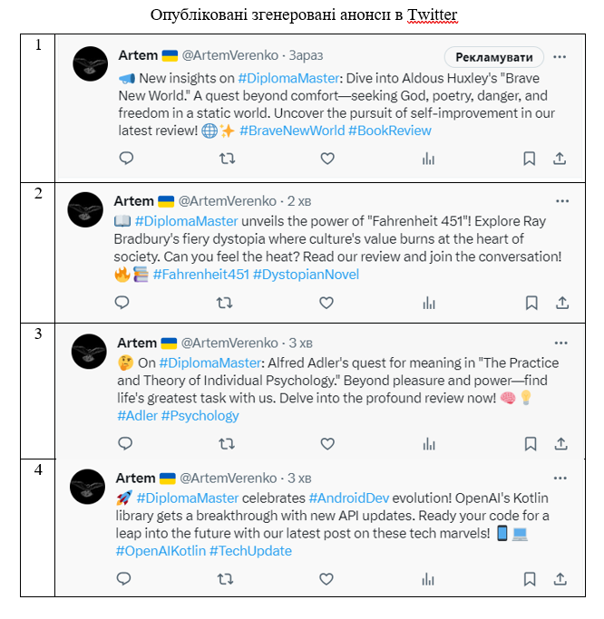
Announcements published on Twitter

Slide 18
THANK YOU

